Slide 1





Sample Capstone Project
Template Course: AI Builder
Title: Food Calorie Prediction
Presented by:
Sahil Jaiswal (hinchlaljaiswal823@gmail.com)
Uma Shankar Mishra (umashankarm655@gmail.com)
Muskan Vaishnav (muskan25ai030@satiengg.in)
Akshat Jain (jainsahabakshatjain@gmail.com)
Anjali Singh (anjalisingh31387@gmail.com)
Course: AI Builder
Course Code:
Mentor Name: Prof. Soorya Suresh
Date:
01/03/2024

Slide 2
Overview
Introduction
Objective
Project Plan
Project Sechdule
Methodology
Architecture
Model Training
Experimental Results
Observation
Conclusion
References

Slide 3
Introduction
Predicting food calories is a process of estimating the energy content of a particular food item based on its ingredients, portion size, and preparation method. It involves utilizing various techniques such as machine learning algorithms, nutritional databases, and image recognition to analyze food composition and provide accurate calorie estimations. This can be valuable for individuals looking to manage their weight, track their nutritional intake, or develop personalized dietary plans.
Purpose: Food calorie prediction aims to estimate the energy content of a food item to assist individuals in managing their dietary intake, weight loss or gain goals, and overall health.
Data Sources: It relies on diverse data sources including nutritional databases, food packaging labels, recipe databases, and sometimes even image recognition technologies.

Slide 4
Objectives
Following is the objective for food calorie prediction :
1. Development: Create a food calorie prediction system.
2. Accuracy: Ensure the system provides accurate estimates of calorie content.
3. User-friendly: Design an intuitive and easy-to-use interface for seamless interaction.
4. Machine Learning: Utilize machine learning techniques to enhance prediction accuracy.
5. Informed Choices: Empower individuals to make informed dietary decisions.
6. Nutritional Management: Support users in managing their nutritional intake effectively.
7. Weight Management: Assist users in achieving their weight management goals.
8. Promotion of Healthier Lifestyles: Encourage healthier eating habits and lifestyles through
informed choices.

Slide 5
Project plan
Phase 1: Planning and Preparation - Define project scope, objectives, and
requirements. - Research existing calorie prediction models and data sources.
- Identify necessary technologies and tools. - Set up project environment and version control.
Phase 2: Data Collection and Preparation - Gather diverse food datasets containing nutritional information. - Clean and preprocess the data, ensuring consistency and accuracy. - Augment the dataset if necessary to improve model performance.
Phase 3: Model Development - Select appropriate machine learning algorithms for calorie prediction. - Train and fine-tune the model using the prepared dataset. - Implement techniques for feature engineering and selection. - Validate the model's performance using cross-validation techniques.
Phase 4: User Interface Development - Design and develop a user-friendly interface for inputting food information. - Integrate the interface with the calorie prediction model. - Implement features for displaying calorie estimates and nutritional information. - Conduct usability testing and gather feedback for iterative improvements.

Slide 6
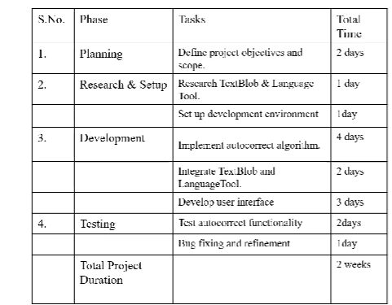
Project Schedule
6

Slide 7
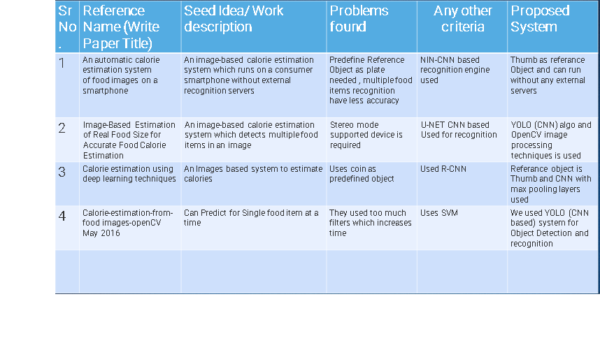
Literature survey

Slide 8
Methodology for Food Calorie Prediction
1. Data Collection:
- Gather diverse datasets containing information on food items and their corresponding
calorie content.
- Include data from reputable nutritional databases, food packaging labels, and recipe
repositories.
2. Data Preprocessing:
- Clean the collected data to remove any inconsistencies, errors, or missing values.
3. Feature Engineering:
- Extract relevant features from the dataset such as ingredient composition, portion size, and cooking
methods.
4. Model Selection:
- Evaluate various machine learning algorithms suitable for regression tasks, such as linear regression,
decision trees, random forests, or neural networks.
5. Model Training:
- Split the preprocessed dataset into training, validation, and testing sets.
6. Hyperparameter Tuning:
- Fine-tune the model hyperparameters to optimize performance.

Slide 9
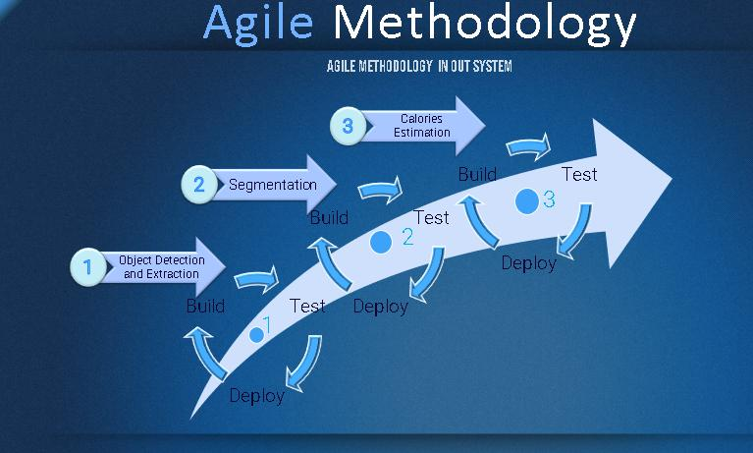

Slide 10
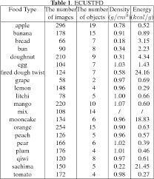
Data Collection
The images in this dataset were scraped from Bing Image Search for a project of mine.
Content
This dataset contains three folders:
train (100 images each)
test (10 images each)
validation (10 images each)
Each of the above folders contains subfolders for different fruits and vegetables wherein the images for respective food items are present

Slide 11
Data Preprocessing:
Data Cleaning:
Remove duplicate entries.
Handle missing values (imputation or removal).
Data Normalization/Standardization:
Normalize numerical features to a similar scale, especially if using algorithms sensitive to scale differences.
Feature Engineering:
Extract relevant features like portion size, cooking method, etc.
Convert categorical features into numerical representations (one-hot encoding).
Outlier Detection and Handling:
Identify and handle outliers appropriately, as they can skew predictions.
Text Data Processing:
If the dataset includes textual information (e.g., food descriptions), use techniques like tokenization, stemming, or lemmatization.
Target Variable Transformation:
If needed, transform the target variable (calories) to achieve a more normal distribution.

Slide 12
Data Augmentation:
Image Data Augmentation:
If you have images of food items, use techniques like rotation, flipping, zooming, or cropping to artificially increase your dataset size.
Synthetic Data Generation:
Generate additional data points synthetically to diversify your dataset, such as creating variations in recipes or ingredient combinations.
Time-based Augmentation:
If your data involves time series (e.g., meal consumption over time), consider creating variations in timestamps or introducing time-related trends.
Nutritional Data Augmentation:
Incorporate additional nutritional information or details about food items to enrich the dataset.
Data Balancing:
Ensure a balanced representation of different classes in your dataset, especially if certain food types are underrepresented.
Noise Injection:
Introduce random noise to the data to make the model more robust and generalize better.

Slide 13
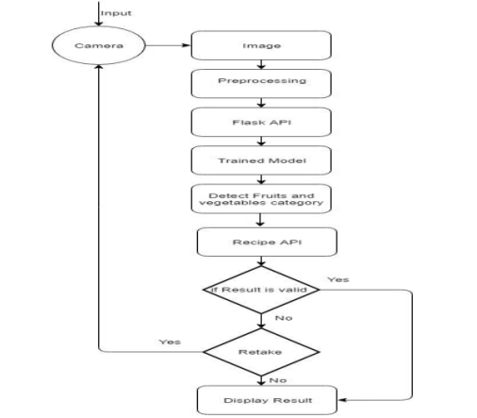
System Architecture

Slide 14
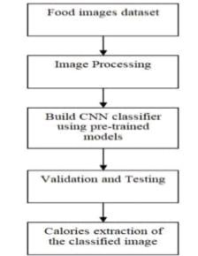
Flow Chart

Slide 15
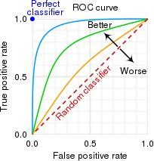
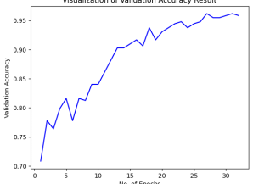
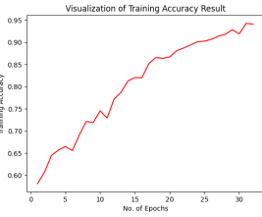
ROC curves, Learning Curves
Use charts, line graphs, Learning curves, ROC
curves, and interpret them.
Dec, 2023
29

Slide 16
Convolution Neural Network
•Computer vision is an interdisciplinary field that has been gaining huge amounts of traction in the recent years.
•Another integral part of computer vision is object detection.
•The difference between object detection algorithms and classification algorithms is that in detection algorithms, we try to draw a bounding box around the object of interest to locate it within the image.
•Not necessarily draw just one bounding box in an object detection case, there could be many bounding boxes representing different objects of interest within the image.
The major reason for not proceeding with CNN model as building a standard convolutional network followed by a fully connected layer is that, the length of the output layer is variable — not constant, this is because the number of occurrences of the objects of interest is not fixed.
•It cannot be implemented real time as it takes around 45 minutes to train the model.

Slide 17
R-CNN
In Faster R-CNN input image to the CNN to generate a convolutional feature map
From the convolutional feature map, identified region of proposals and warp them into squares and by using a RoI pooling layer, reshape them into a fixed size so that it can be fed into a fully connected layer.
From the RoI feature vector, a softmax layer to predict the class of the proposed region and also the offset values for the bounding box
.The reason “Fast R-CNN” is faster than R-CNN is because you don’t have to feed 2000 region proposals to the convolutional neural network every time. Instead, the convolution operation is done only once per image and a feature map is generated from it

Slide 18
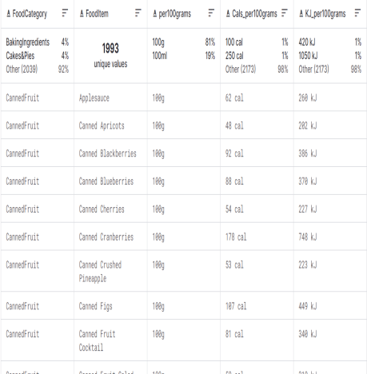
Calories Extraction
After anlysing the food image and detecting the type of food , our classifier can be employed and estimate the calories content of the food based dataset . the classifies provide an accurate the estimated process.

Slide 19
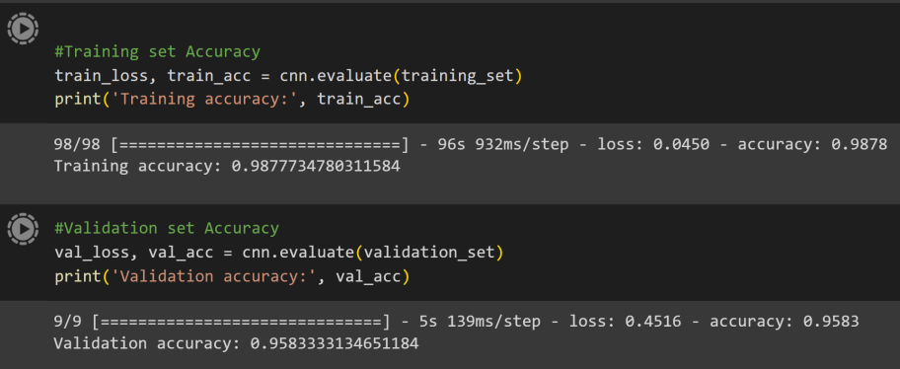
Experimental Results

Slide 20
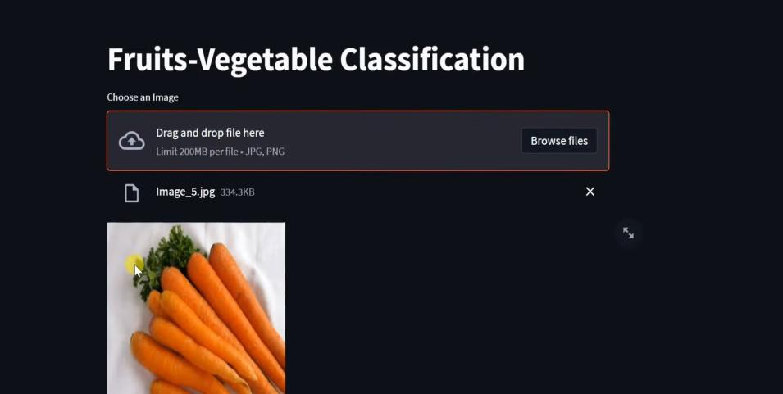
IMPLEMENTATION

Slide 21
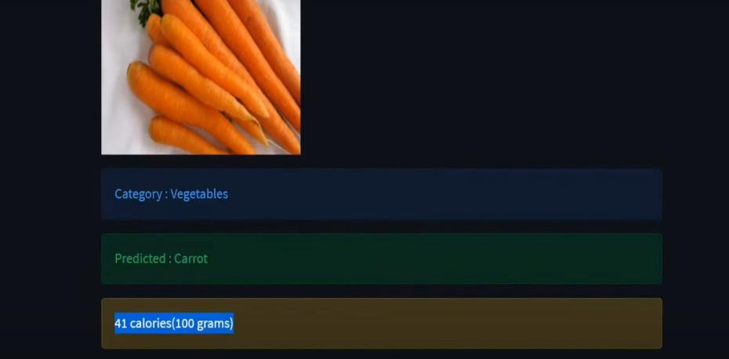
OUTPUT

Slide 22
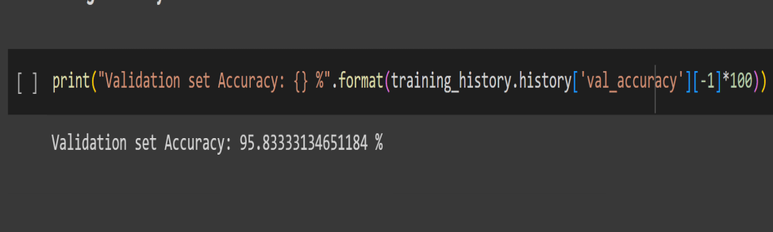

Slide 23
we have combined Graph cut segmentaon and deep neural network.
The combinaon of these two methods allow to improve the accuracy of food classicaon and recognion.
Before the implementaon of the image recognion algorithm in the Android applicaon, the rst step in our approach is to generate a pre-trained model with the help of CNN network.
System could recognize the food porons very accurately in 3 seconds.
The results of table I show that we have 98% accuracy in our single food porons. Results shows the average calories are so close to the real one and also the small rane of standard error also shows the accurac of the sstem.

Slide 24
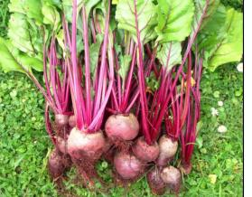
Sample Images
Fig. Sample Images ( It is a test image)
24

Slide 25
Observations:
- CNNs outperform traditional machine learning models and neural networks.
- CNNs demonstrate superior predictive performance, with lower MAE and MSE, and higher R².
- The hierarchical feature extraction capabilities of CNNs are beneficial for processing food images and capturing spatial dependencies.
- Transfer learning with pretrained CNN models can further improve performance, especially with limited training data.

Slide 26
Conclusion
Model Performance Evaluation: - Experimental results evaluated various machine learning models for food calorie prediction. - Convolutional Neural Networks (CNNs) demonstrated superior performance compared to traditional machine learning models and neural networks.
CNN Efficacy: - CNNs, particularly adept at processing image data, showed promise in accurately estimating calorie content from food images. - Hierarchical feature extraction capabilities enabled CNNs to capture spatial dependencies effectively.
Transfer Learning Advantage:- Transfer learning from pretrained CNN models further improved performance, especially with limited training data. - Pretrained CNNs provided a foundation for learning complex food representations, enhancing prediction accuracy.
Predictive Performance Metrics:- CNNs exhibited lower mean absolute error (MAE) and mean squared error (MSE), and higher R-squared (R²) values compared to other models. - These metrics indicate the superior predictive accuracy and ability of CNNs to explain variance in calorie predictions.
26

Slide 27
Empower the user by a convenient, intelligent and accurate system that helps them become sensible about their calorie intake.
We employed a rather unique combinaon of graph cut segmentaon and deep learning neural networks as a means of accurately classifying and recognizing food items.
The combinaon of those two methods provides a powerful instrument to aain a100 % accuracy of food recognion in our system.
The implementaon of the virtualizaon approach of the applicaon which allows us to benet from cloud based resources.
Future work is to increase our database of images and use the approach presented in this paper to test mixed food porons

Slide 28
References
Dataset - https://www.kaggle.com/datasets/kritikseth/fruit-and-vegetable-image-recognition
https://youtube.com/playlist?list=PLvz5lCwTgdXByZ_z-LFo4vJbbFIMPhkkM&si=uvTGHf3tzAwex8MA
28

Slide 29
Team Contribution
Uma Shankar Mishra- Researching and implement models for image recognition and classification and explore architecture
parameters.
Muskan Vaishnav - Training the developed models using the preprocessed dataset , monitoring their performance and presentation
preparation.
Sahil Jaiswal - Collecting a diverse dataset of food images along with their corresponding calorie information and preprocessing on
dataset
Anjali Singh - Data Preprocessing, Normalization and data cleaning.
Akshat Jain - Data collection, Data Cleaning, model architecture and report preparation.

Slide 30
THANK YOU

